Slide 1
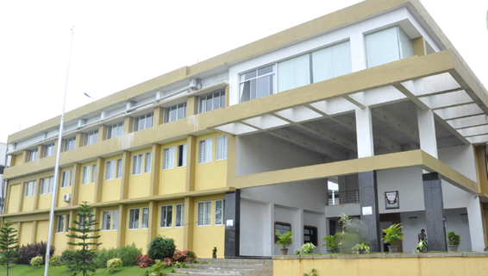

JYOTHY INSTITUTE OF TECHNOLOGY

Slide 2


Friend Finder
Under the guidance of
Mr. HARISH K
Submitted By
RAKESH S[1JT13CS036]
YASHASWINI N[1JT13CS056]
SANKET S KULKARNI[1JT13CS042]
NAGBHUSHAN H S[1JT13CS029]

Slide 3

Problem Statement
In today’s scenario of metropolitan cites it is very difficult to stay in contact with friends or informing parent’s whereabouts. The idea was to make an application for mobile devices that would make it easier for the user to stay in touch with friends. The application is able to gather information of the phone’s GPS locations from the phone and present the information in a simple and convenient way.

Slide 4
Proposed System
Friend Finder app will keep track of the user location co-ordinates using the FusedLocationApi and updates the firebase real-time database as per the requirement.
Firebase stores the user information by creating the new child as user phone number.
The firebase data can be retrieved by user upon proving the phone number.
The obtained location co-ordinated are then represented in the Google map.
User can store the data in the local database.

Slide 5
GoogleApiClient
The main entry point for Google Play services integration.
GoogleApiClient is used with a variety of static methods
GoogleApiClient.ConnectionCallbacks - Provides callbacks that are called when the client is connected or disconnected from the service.
GoogleApiClient.OnConnectionFailedListener - Provides callbacks for scenarios that result in a failed attempt to connect the client to the service.

Slide 6
Firebase Authentication
FirebaseAuth is the entry point for firebase authentication.it can be initialized by calling static method getInstance().
Using this user can sign In with the google account to app.
For every user a unique user id called UID will be generated by firebase.
GoogleSignInApi – it’s an interface to the sign in with google added to the FirebaseAuth class as,
FirebaseAuth.GoogleSignInApi.getSignInIntent(googleApiClient);

Slide 7
FusedLocationApi
It is the main entry point for interacting with Fused location provider.
Fused Location Provider analyses GPS, Cellular and Wi-Fi network location data in order to provide the highest accuracy data.
Fused location provider can be used to get periodic location updates of user location.
A user can define one of the 3 main fused location provider modes are HIGH_ACCURACY, BALANCED_POWER or NO_POWER

Slide 8
Requesting Location Updates
By setting priority as HIGH_ACCURACY, BALANCED_POWER or NO_POWER.
By setting the smallest displacement of user in meters.
By setting the time interval in milliseconds.

Slide 9
GoogleMap
This is the main class of the Google Maps Android API and is the entry point for all methods related to the map.
we cannot instantiate a GoogleMap object directly, rather, we have to obtain one from the getMapAsync() method on a MapFragment that will be added to the application.
The override method onMapReady() of OnMapReadyCallback will be called when map will be ready to be used.

Slide 10
Adding a Marker
Marker can be added to the location by calling a method on object.
mMap.addMarker();
mMap.moveCamera();
mMap.clear();

Slide 11
Real-Time Database
In Firebase Data is stored and synchronized in realtime to every connected client. all the clients shareRealtime Database every user will have one instance and automatically receive updates with the newest data.
DatabaseReference dbRef = FirebaseDatabase .getInstance() .getReference();
dbRef.child(phoneNumber).setValue(userData);

Slide 12
Real-Time Database
The data stored in the firebase can be retrieved as-
dbRef.child(phoneNumber) .addValueEventListener
public void onDataChange(DataSnapshot dataSnapshot) { UserData userData =dataSnapshot.getValue(UserData.class);
}

Slide 13
Thank You…

